Slide 1
My Applications Interactive Notebook
Name
Class AEMAA 1
Teacher Mrs Keen
Term 2 Semester 2
1

Slide 2
Create your own front page
It needs to contain the following –
My applications interactive notebook
Name
Class
Teachers Name
Semester 2 Term 2
Page number 1

Slide 3
Contents
Glossary or Formula Page
Page
Date
Description
2
3

Slide 4
Tasks
24
7
30
Essential Question
Questions
Notes
Summary
4
5

Slide 5
24
7
30
Date
Topic
Data
EQ – What is the difference between nominal and ordinal data?
5

Slide 6
24
7
30
Date
Topic
Data
EQ – What is the difference between nominal and ordinal data?
Types of data:
5

Slide 7
24
7
30
Date
Topic
Data
EQ – What is the difference between nominal and ordinal data?
Types of data:
Primary: data we collect ourselves
5

Slide 8
24
7
30
Date
Topic
Data
EQ – What is the difference between nominal and ordinal data?
Types of data:
Primary: data we collect ourselves
Secondary: data collected by others
5

Slide 9
24
7
30
Date
Topic
Data
EQ – What is the difference between nominal and ordinal data?
Types of data:
Primary: data we collect ourselves
Secondary: data collected by others
Univariate: one variable
5

Slide 10
24
7
30
Date
Topic
Data
EQ – What is the difference between nominal and ordinal data?
Types of data:
Primary: data we collect ourselves
Secondary: data collected by others
Univariate: one variable
Bivariate: two variables
5

Slide 11
24
7
30
Date
Topic
Data
EQ – What is the difference between nominal and ordinal data?
Types of data:
Primary: data we collect ourselves
Secondary: data collected by others
Univariate: one variable
Bivariate: two variables
Categorical: associated with categorical data (lets us out the response into a category or group)
5

Slide 12
24
7
30
Date
Topic
Data
EQ – What is the difference between nominal and ordinal data?
Types of data:
Primary: data we collect ourselves
Secondary: data collected by others
Univariate: one variable
Bivariate: two variables
Categorical: associated with categorical data (lets us out the response into a category or group)
Categorical Variables
5

Slide 13
24
7
30
Date
Topic
Data
EQ – What is the difference between nominal and ordinal data?
Types of data:
Primary: data we collect ourselves
Secondary: data collected by others
Univariate: one variable
Bivariate: two variables
Categorical: associated with categorical data (lets us out the response into a category or group)
Categorical Variables
Nominal
Based purely on the names of various categories, no order
5

Slide 14
24
7
30
Date
Topic
Data
EQ – What is the difference between nominal and ordinal data?
Types of data:
Primary: data we collect ourselves
Secondary: data collected by others
Univariate: one variable
Bivariate: two variables
Categorical: associated with categorical data (lets us out the response into a category or group)
Categorical Variables
Nominal
Based purely on the names of various categories, no order
Ordinal
Names of the categories (labels) suggest an order
5

Slide 15
24
7
30
Date
Topic
Data
EQ – What is the difference between nominal and ordinal data?
Displaying Categorical data:
5

Slide 16
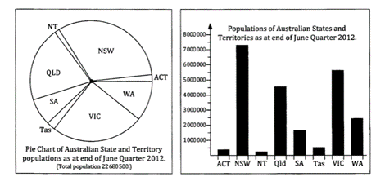
24
7
30
Date
Topic
Data
EQ – What is the difference between nominal and ordinal data?
Displaying Categorical data:
Pie Chart
Bar Graph
5

Slide 17
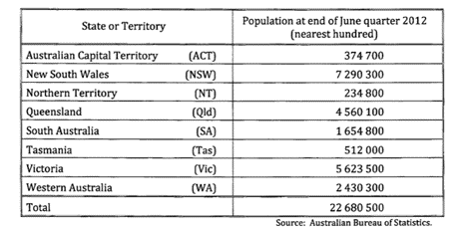
24
7
30
Date
Topic
Data
EQ – What is the difference between nominal and ordinal data?
Displaying Categorical data:
Pie Chart
Bar Graph
Table
5

Slide 18
24
7
30
Date
Topic
Data
EQ – What is the difference between nominal and ordinal data?
Displaying Categorical data:
Pie Chart
Bar Graph
Table
*all this is nominal data
5

Slide 19
Task
Complete all the questions on page 17
N.B.
What you don’t complete in class becomes homework and will be checked on Thursday!

Slide 20
Task
Complete all the questions on page 17
N.B.
What you don’t complete in class becomes homework and will be checked on Thursday!
and…

Slide 21

Task
Complete all the questions on page 17
N.B.
What you don’t complete in class becomes homework and will be checked on Thursday!
and… SMILE!

Slide 22
Notes Review
24, 7 ,30
Date
Title
Essential question
Notes complete
Notes complete with colour and diagrams
Questions completed
Contents page filled in
Formula page filled in

Slide 23
Homework
Review your notes and write a summary answering the essential question.

